Slide 1
Introduction to Operating System
Alok Jhaldiyal
Assistant Professor
SoCS, UPES
Dehradun

Slide 2
General Information
Textbook:
Operating System Concepts, 8th or 9th Ed, by Silberschatz, Galvin, and Gagne
Reference Books:
Operating Systems: Principles and Practice by Anderson and Dahlin
Modern Operating Systems by Andrew Tanenbaum
Programming assignments will be covered in associated Lab.
OS

Slide 3
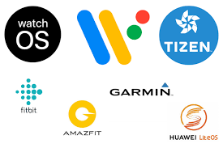
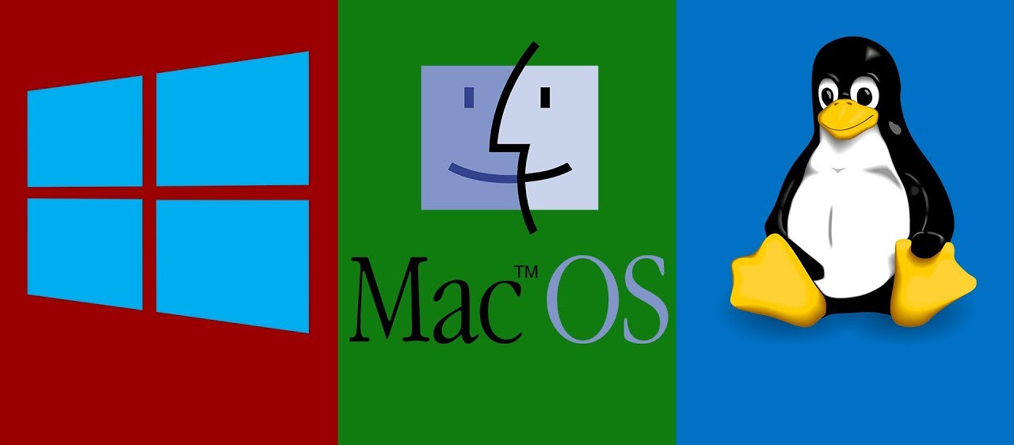
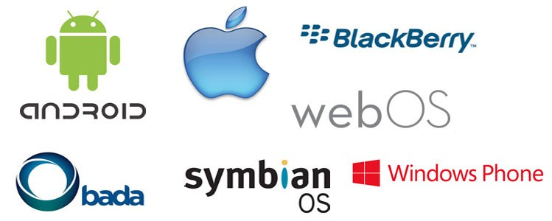
Our Exposure to various OS’s

Slide 4
Computer System
computer system can be divided roughly into four components:
Hardware
The central processing unit (CPU), the memory, and the input/output (I/O) devices
Provides the basic computing resources for the system
Operating System
Controls the hardware and coordinates its use among the various application programs for the various users
Operating System provides the means for proper use of these resources.
Application Programs
Define the ways in which these resources are used to solve users’ computing problems
Application Programs: Word Processors, spreadsheets, compilers, browsers……
Users

Slide 5
What is operating system?
User-centric definition
A program that acts as an intermediary between a user of a computer and the computer hardware
Defines an interface for the user to use services provided by the system
Provides a “view” of the system to the user Converts what the hardware gives to what the user wants
The view can hide many details of the hardware that the user does not need to know
Can even give a very different view of the operating environment to the user than what is actually there

Slide 6
System-centric definition
Efficiently manages and allocates resources to users
Controls the execution of user programs and operations of I/O devices
Provides isolation/protection between different user programs

Slide 7
Abstract View of System Components

Slide 8
Types of System
Batch Systems
Multiple jobs, but only one job in memory at one time and executed (till completion) before the next one starts
Multiprogrammed Batch Systems
Multiple jobs in memory, CPU is multiplexed between them
CPU-bound vs I/O bound jobs
Time-sharing Systems
Multiple jobs in memory and on disk, CPU is multiplexed among jobs in memory, jobs swapped between disk and memory
Allows interaction with users

Slide 9
Personal Computers
Dedicated to a single user at one time
Multiprocessing Systems
More than one CPU in a single machine to allocate jobs to
Symmetric Multiprocessing, NUMA machines …
Multicore
Other Parallel Systems, Distributed Systems, Clusters…
Different types of systems with multiple CPUs/Machines
Real Time Systems
Systems to run jobs with time guarantees
Many other types
Embedded systems, mobiles/smartphones, ….

Slide 10
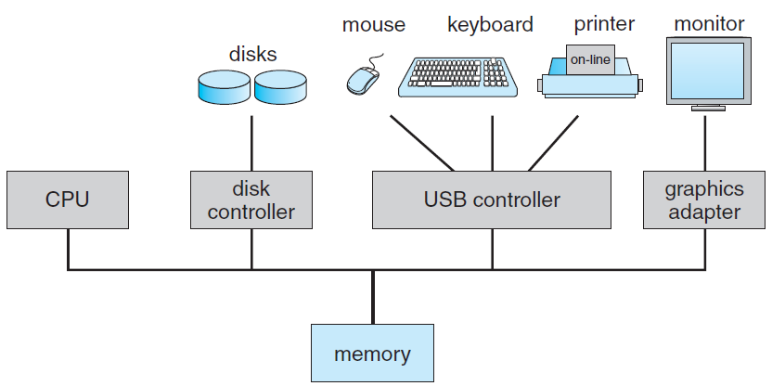
Computer System Architecture
Computer system consists of one or more CPUs and a number of device controllers, which execute in parallel.
Each device controller is in charge of a specific type of device.
For orderly access to the shared memory, a memory controller synchronizes access to the memory

Slide 11
Bootstrap program
Once computer is powered on, to start running a initial program: Bootstrap Program
Initializes all aspects of the system, from CPU registers to device controllers to memory contents.
Stored within the computer hardware in read-only memory (ROM)
Bootstrap program locates the operating-system kernel and loads it into memory
A loaded and executing kernel provides services of the system to the user.
Some services are provided outside of the kernel, by system programs that are loaded into memory at boot time to become system processes

Slide 12
Bootstrap Steps
Loading the code and initializing the kernel
Detecting the Devices and configuring them
Creating spontaneous system processes
Operator intervention (manual boot only)
Execution of system startup scripts
Multiuser operation

Slide 13
Kernel
Core component of operating system
Unix kernels provide an execution environment in which applications may run
Interfaces between the three major computer hardware components
Application/user interface
The CPU
Memory
I/O devices.
Kernel also sets up memory address space for applications, loads files with application code into memory

Slide 14
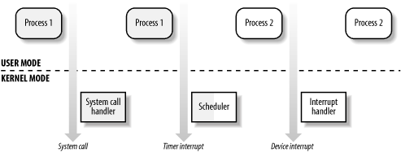
Transitions Between User and Kernel Mode
Process 1 in User Mode issues a system call, after which the process switches to Kernel Mode and the system call is serviced.
Process 1 then resumes execution in User Mode until a timer interrupt occurs and the scheduler is activated in Kernel Mode
A process switch takes place and Process 2 starts its execution in User Mode until a hardware device raises an interrupt.
As a consequence of the interrupt, Process 2 switches to Kernel Mode and services the interrupt.

Slide 15
Homework
Case Study 1: Study and document the Unix bootstrap process.
Submission Date: 23/08/2023

Slide 16
Interrupts
Occurrence of an event is usually signalled by an interrupt from either the hardware or the software.
When the CPU is interrupted, it stops what it is doing and immediately transfers execution to a fixed location.
Fixed location usually contains the starting address where the service routine for the interrupt is located.
On completion of service routine the CPU resumes the interrupted computation.

Slide 17
Storage Structure
CPU can load instructions only from memory, so any programs to run must be stored there.
Mostly computer access there programs from Random Access Memory (RAM)
Static programs such as Bootstrap are stored in ROM.
All forms of memory provide an array of bytes, each byte having its own address.
Sequence of load or store instructions maintains the execution.
Load instruction moves a byte or word from main memory to an internal register within the CPU.
Store instruction moves the content of a register to main memory

Slide 18
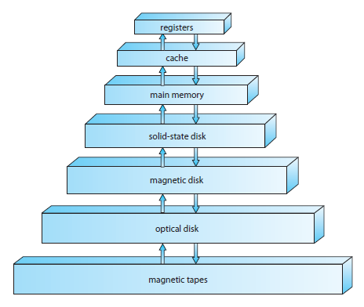
Memory Access Speed
is increasing in which
direction????
Storage-device hierarchy

Slide 19
I/O Structure
A large portion of operating system code is dedicated to managing I/O.
Device controller who is in charge of a specific type of device, maintains some local buffer storage and a set of special-purpose registers.
To start an I/O operation, the device driver loads the appropriate registers within the device controller.
Device driver then informs the operating system that the data is loaded and is ready.

Slide 20
Operating System Operations
Process Management
A program in execution, as mentioned, is a process.
A word-processing program being run by an individual user on a PC is a process.
A process needs certain resources—CPU time, memory, files, and I/O devices.
Activities in connection with process management:
Scheduling processes and threads on the CPUs
Creating and deleting both user and system processes
Suspending and resuming processes
Providing mechanisms for process synchronization

Slide 21
Memory Management
Main memory is central to the operation of a modern computer system
Main memory is a repository of quickly accessible data shared by the CPU and I/O devices.
For a program to be executed, it must be mapped to absolute addresses and loaded into memory.
Program executes by accessing program instructions from memory by their absolute addresses.
Program terminates and its memory space is declared available
Activities in connection with memory management:
Keeping track of which parts of memory are currently being used and who is using them
Deciding which processes (or parts of processes) and data to move into and out of memory.
Allocating and deallocating memory space as needed.

Slide 22
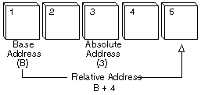
Absolute Address:
A fixed address in memory
Is not a relative address
Also called real addresses

Slide 23
Storage Management
Operating system provides a uniform, logical view of information storage, a logical unit, the file
OS maps files onto physical media and accesses these files via the storage devices.
Activities in connection with storage management:
File System Management
Mass storage management
Caching
I/O Systems
File system management:
Creating and deleting files
Creating and deleting directories to organize files
Supporting primitives for manipulating files and directories
Mapping files onto secondary storage
Backing up files on stable (nonvolatile) storage media

Slide 24
Storage Management
Mass-Storage Management
Free-space management
Storage allocation
Disk scheduling
Caching
I/O Systems
A memory-management component that includes buffering, caching, and spooling
A general device-driver interface
Drivers for specific hardware devices

Slide 25
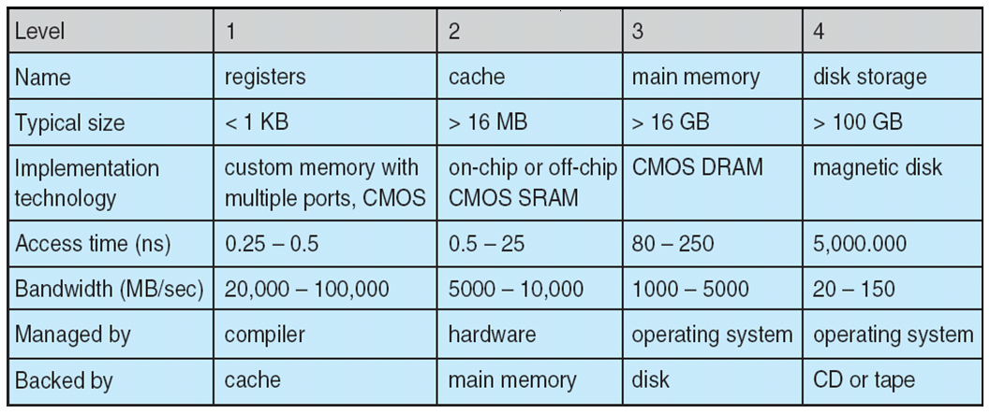
Performance of Various Levels of Storage
Movement between levels of storage hierarchy can be explicit or implicit

Slide 26
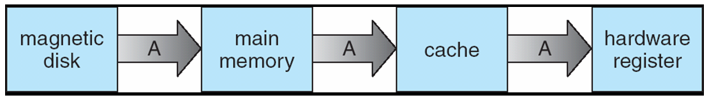
Migration of Integer A from Disk to Register
Multitasking environments must be careful to use most recent value, no matter where it is stored in the storage hierarchy
Multiprocessor environment must provide cache coherency in hardware such that all CPUs have the most recent value in their cache

Slide 27
Protection and Security
Protection, then, is any mechanism for controlling the access of processes or users to the resources defined by a computer system.
Job of security is to defend a system from external and internal attacks which may include viruses and worms, denial-of service attacks, identity theft and theft of service.

Slide 28
Modes of Operating System
Operating System is interface between applications and the underlying hardware.
At the same time to maintain systems integrity, it needs to prevent system integrity from application accessing hardware directly.
Mode Bit is added to the hardware to indicate current mode.
To enforce this protection, CPU provides two modes of operation:
Kernel Mode
User Mode

Slide 29
User Mode
Direct access to the hardware is prohibited, and so is any arbitrary switching to kernel mode.
For a user-mode application, Windows creates a process for the application.
Process provides the application with a private virtual address space and a private handle table.
As virtual address space is private, one application cannot alter data that belongs to another application.
If an application crashes, the crash is limited to that one application

Slide 30
Kernel Mode
Known as supervisor mode or privileged mode.
Has complete access to all of the computer's hardware and can control the switching between the CPU modes.
Code that runs in kernel mode shares a single virtual address space
If a kernel-mode driver accidentally writes to the wrong virtual address, data that belongs to the operating system or another driver could be compromised
If a kernel-mode driver crashes, the entire operating system crashes

Slide 31
Operating system classification
Operating Systems can be classified as:
GUI: Graphical User Interface operating systems are operating systems that have the capability of using a mouse and are graphical
Multi user: allows multiple users to utilize the computer and run programs at the same time
Multi processing: allows multiple processors to be utilized
Multi tasking: allows multiple software processes to be run at the same time
Multi threading: allows different parts of a software program to run concurrently

Slide 32
Distributed Operating Systems
Distributed systems are loosely coupled systems
A Distributed computer system is a collection of autonomous computer systems
Distributed systems communicate with one another through various communication lines like high speed buses or telephone lines
The processors in a distributed system may vary in size and function
Example: small microprocessors, workstations , minicomputer and large general purpose computers

Slide 33
Distributed Operating Systems
Processors in distributed systems are referred by no. of different names like, sites, nodes, computers, etc.
Important reasons for building distributed systems are
Resource sharing
Computation speedup
Reliability
Communication
The key objective of a distributed operating system is transparency
Ideally, component and resource distribution should be hidden from users and applications programs unless they explicitly demand

Slide 34
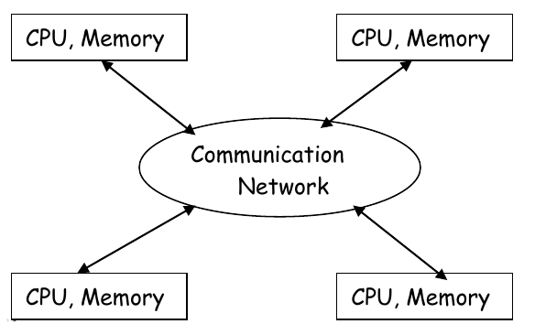

Slide 35
Real Time Operating System
Real-time systems has well defined, fixed time constraints
Processing must be done with in the defined constraints, or the system will fail
For example:
Weather Forecasting, Self driving Cars, Earthquake warning systems, wireless sensor networks

Slide 36
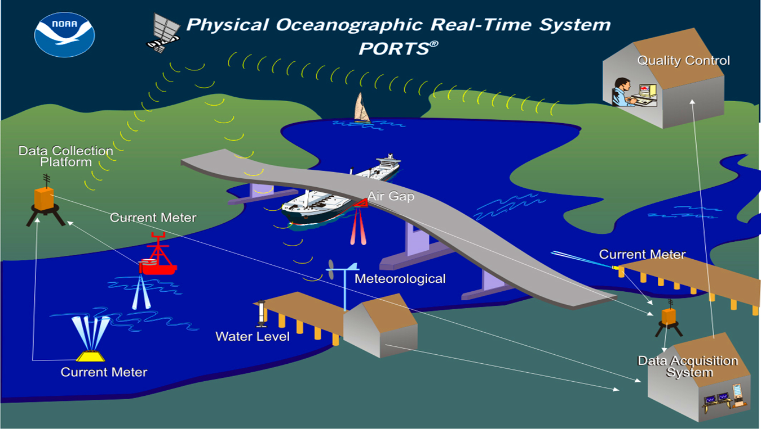

Slide 37
Real Time Operating System
Real-time system is used as a control device in a dedicated application
Sensors bring data to computers
Computer analyze data and adjust controls to modify the sensor inputs
Example:
Scientific experiments, medical imaging systems, industrial control systems etc..
Real-time system functions correctly only if it returns the correct result within its time constraints

Slide 38
Real Time Operating System
A primary objective of real-time systems is to provide quick event - response times, thus meet the scheduling dead lines
User convenience and resource utilization are of secondary concern to real- time system designers
Real-time operating systems usually rely on some specific policies and techniques for doing their job

Slide 39
System Calls
The mechanism used by an application program to request service from the operating system.
System calls often use a special machine code instruction which causes the processor to change mode (Protected or Supervisor mode)
This allows the OS to perform restricted actions such as accessing hardware devices or the memory management unit

Slide 40
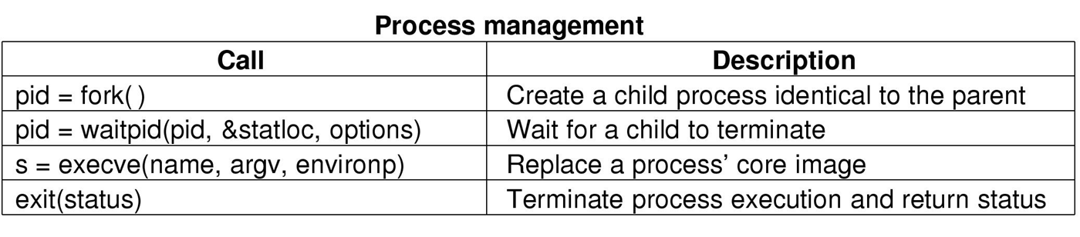
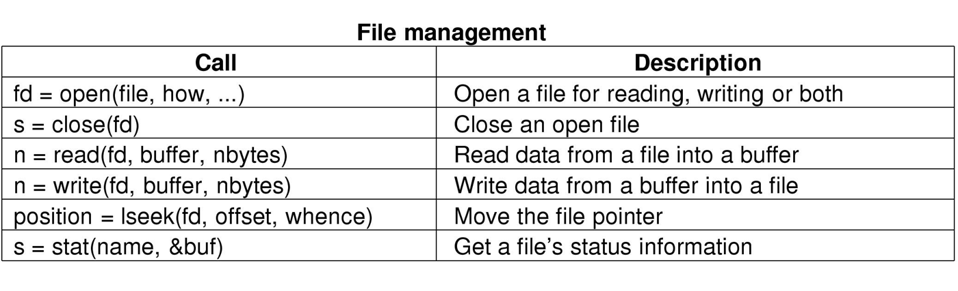
Types of System Call

Slide 41
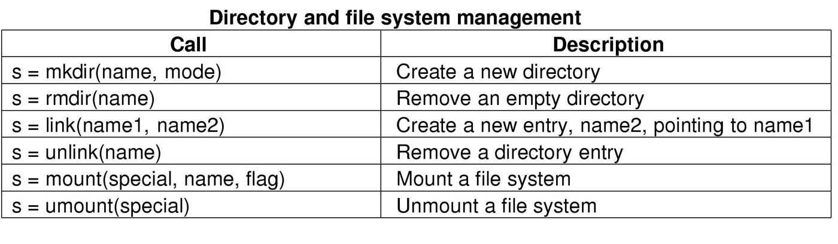
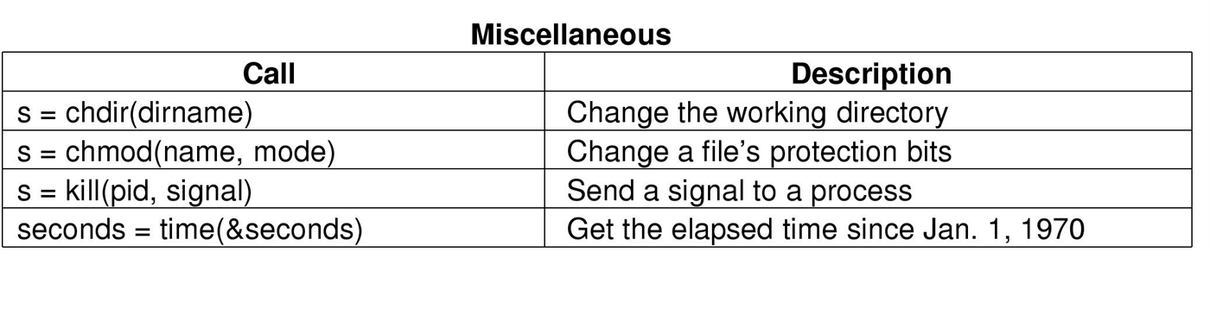
Types of System Call

Slide 42
System Calls Vs API Call
Processes in a system runs in different modes, process running in user mode have no access to the privileged instructions.
If process want perform any privileged instruction or need of any services they request kernel for that service through System Calls.
API is generic term used to identify the functions exposed by any libraries.
These functions are implemented as part of libraries, or SDK.
System call is when you call the kernel, whereas a System API are used to invoke system call.

Slide 43
Computing Environments
Traditional computer
Office environment
PCs connected to a network, terminals attached to mainframe or minicomputers providing batch and timesharing
Now portals allowing networked and remote systems access to same resources
Home networks
Used to be single system, then modems
Now firewalled, networked

Slide 44
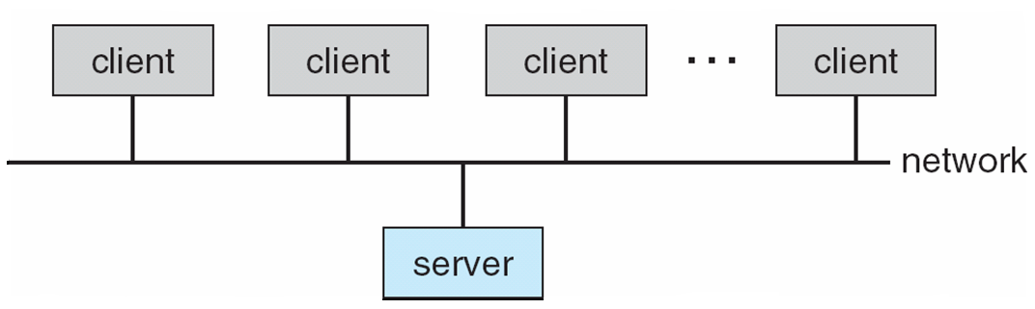
Computing Environments
Client-Server Computing
Dumb terminals supplanted by smart PCs
Many systems now servers, responding to requests generated by clients
Compute-server provides an interface to client to request services (i.e., database)
File-server provides interface for clients to store and retrieve files

Slide 45
Peer to Peer Computing
Another model of distributed system
P2P does not distinguish clients and servers
Instead all nodes are considered peers
May each act as client, server or both
Node must join P2P network
Registers its service with central lookup service on network, or
Broadcast request for service and respond to requests for service via discovery protocol
Examples include Napster and Torrentz

Slide 46
Web Based Computing
Web has become ubiquitous
PCs most prevalent devices
More devices becoming networked to allow web access
New category of devices to manage web traffic among similar servers: load balancers
Use of operating have evolved into OS’es which can be clients and servers

Slide 47
Class Activity
What is a interrupt and how it is handled? Explain by exploring a real life case of some Unix system interrupt.
What are the five major activities of an operating system in regard to file management?
Explore fork() and exec() system call. Argue if both system calls are same or different.
What is a bootstrap program? Explain key actions of bootstrap program.

Slide 48
Thank You

